Slide 1
Object Oriented Concepts

Slide 2

Objectives
At the end of this session, you will be able to
Introduce Object Oriented Programming
Identify Classes & Objects
Understand Object Oriented Concepts
Abstraction
Encapsulation
Inheritance
Polymorphism

Slide 3
Agenda
Object Oriented Programming
Classes & Objects
OO Features
Abstraction
Encapsulation
Inheritance
Polymorphism

Slide 4
Programming Paradigms
Programming Paradigm refers to the methodology used for programming.
Procedure Oriented Programming
Decide which modules you want; partition the program so that data is hidden in modules
Importance is given to algorithm rather than data
Object Oriented Programming (OOP)
Decide which types you want; provide a full set of operations for each type
Importance is given to data (Objects) & algorithm supports the data

Slide 5
Programming Paradigms
Procedural Languages | Object Oriented Languages
The basic unit is a function | The basic unit is a class
Importance is given to the sequence of tasks to be done | Importance is given to the data.
Larger programs are divided into functions | Larger programs are divided into objects.
Most functions share global data | Mostly the data is private and only functions inside the object can access the data.
Follows a top down approach in problem solving | Follows a bottom up approach.

Slide 6
Need of OOP
World is made up of objects!
Purchasing a product
Manufacturer
Client
Orders
Manufactures
Truck
Ship via
Product
Airplane

Slide 7
Object Oriented Programming
Object Oriented Programming is an easy way of transforming real world problem into software
Fundamental knowledge of object oriented concepts is necessary to adopt Object Oriented Programming paradigm for software

Slide 8
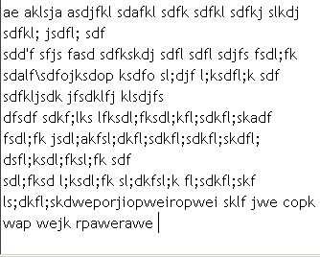
Object
An object represents an entity, either physical or conceptual
Every entity in the world is an object
An Object has:
State
Behavior
Identity
Physical Entity
Conceptual Entity (Programatic)
Truck
Linked List Data Structure
Conceptual Entity
Paragraph

Slide 9
Object Characteristics - State
The state of an object is one of the possible conditions in which an object may exist
State is represented by the values of the attributes
The state of an object changes by Behavior
Object
Object State
A. B. Chowbe
10000
04/01/2016
Teaching
Name
Employee No
Date of joining
Status
A. B. Chowbe

Slide 10
Object Characteristics - Behavior
Method in a class exhibits the behavior of a class
Behavior determines how an object responds to requests from other objects
Behavior is represented by the set of messages it can respond to. Messages are operations that the object can perform.
Course Allotment
(confirmation)
Registration Manager
A.B.Chowbe

Slide 11
Object Characteristics - Identity
Every object has an unique identity. Two objects may have same state, but can not have same identity.
Even if states of two objects are same, their identities should be different. (Employee No. may work as identity)
A.B.Chowbe teaches OOP
A.B.Chowbe teaches OOP

Slide 12
Class & Object
A Class is a description of a group of objects with common properties (attributes) & behavior (operations)
It serves like a blue print or prototype or template for creating objects
An Object is an instance of a class.
All objects have state and behaviour which is defined by its class
Teacher
P.A.Walter
G.A.Khanna
A.B.Chowbe

Slide 13
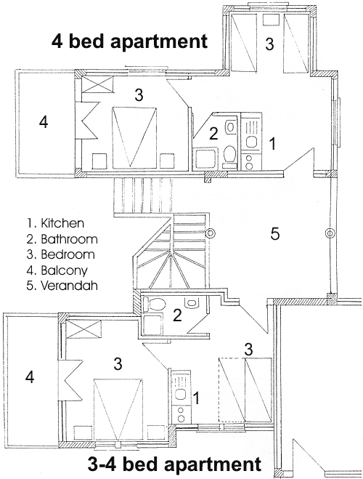
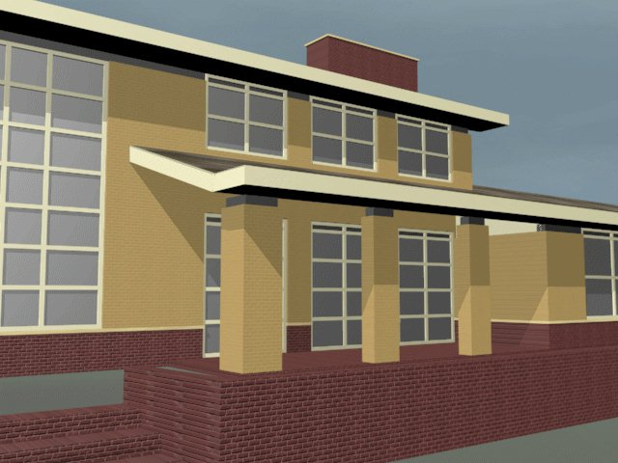
Class & Object
Class is a blueprint of an object

Slide 14



Try it out
1. Try to identify some properties and behaviors for the below objects.

Slide 15
Object Oriented Concepts
Abstraction
Encapsulation
Inheritance
Polymorphism

Slide 16

Abstraction
Abstraction is the process of hiding the details and exposing only the essential features of a particular concept or object
Example:
Telephone has a lot of attributes such as colour, shape, model and behaviors such as receive call, make call etc. Internally, it is made up of circuits, chips and other components. But to buy or use a Telephone, we don't need to know the internal workings of the phone.
CONFIDENTIAL© Copyright 2007 Tech Mahindra Limited
16

Slide 17
Encapsulation
Implementation details are hidden from the outside world
Encapsulation is the way by which abstraction is achieved
Data variables, or fields, are hidden from the user of the object
Methods, or functions, provide an explicit service to the user of the object but hide the implementation.
It also facilitates the bundling of data with the methods operating on that data.
Example: The electronic circuit used in the telephone is hidden from the user.
Data
State (Data) is kept accessible only to a set of functions. Behavior of the object is exposed using methods.
Function

Slide 18
Interface
An interface provides a collection of operations that are used to specify a service of a class or a component
Objects define their interaction with the outside world through the methods that they expose in the interface
It is a contract that specifies the methods which need to be implemented by the class implementing it.
Eg. The buttons on the front of your television set, for example, are the interface between you and the electrical wiring inside.

Slide 19
Message Passing among Objects
Data
Data
Function
Function
An object communicates with another object by passing messages (invoking methods)
Data
Data
Function
Function
Notes:
The above diagram represents a simple OO program
The boxes represent the objects
The circles inside the boxes signify the data hiding concept. It implies that the data is secure
The arrows represent the messages that are sent across (or the methods invoked)

Slide 20
Relationship among Classes
Composition (Has-A Relationship)
Defines a composite object type
A class has an object of another class as its attribute
Example:
Object of Color is an attribute of Automobile class
Automobile
Color shade
Has-A Relationship
Color
string name
int red
int green
int blue

Slide 21
Relationship among Classes
Inheritance (IS-A Relationship)
The feature by which a class acquires the properties and behaviours of another class
When the classes have ‘is a kind of’ relationship between them, this relationship is inheritance
Art
Generalization
Parent- Child relationship
(Is-A Relationship)
Music
Films
Classical Rap
Specialization
Commercial Documentary

Slide 22
Types of Inheritance
Single inheritance
Classes with single parent class
Ancestor
Bank Account
Superclass/Base class
(parent)
balance
name
number
Withdraw()
Generalization Relationship
CreateStatement()
Subclasses
Current Account
Saving Account
Withdraw()
Descendants
GetInterest()
Withdraw()

Slide 23
Types of inheritance
Multiple inheritance
One class has more than one parent class
Super Class/Parent Class/Base Class
Subclass/Child Class/Derived Class
Flying Entity
Animal
multiple inheritance
Airplane
Helicopter
Bird
Wolf
Horse

Slide 24
What is inherited?
A subclass inherits its parent’s attributes & operations
A subclass may:
Add additional attributes & operations
Redefine inherited operations (i.e. overriding)
Common attributes & operations are shown at the highest applicable level in the hierarchy

Slide 25
Polymorphism
The ability of one thing to appear in many forms depending on context
Same functionality is implemented in
different devices in different manner.
Sony TV
Samsung TV
Sansui Video
Volume
Control
Volume Control
Common Interface
Volume Control
Volume Control
Channel Control
Surrounding control
Sound Equaliser control
Remote

Slide 26
Polymorphism
The ability of the objects to respond to the same message in different ways is also called as polymorphism
3. Give me a ring
4. Gives an engagement ring
2. Dial a phone no.
1. Give me a ring

Slide 27
Overloading & Overriding
Two ways of achieving Polymorphism
Overloading
The ability of the objects to respond to the same message in different ways is achieved using overloading
Overriding
The ability to respond differently than the parent, is achieved using overriding

Slide 28
Try it out
Q1. ________ is the mechanism that binds together code and the data it manipulates, and keeps both safe from outside Interference and misuse.
a. Polymorphism b. Garbage Collection
c. Encapsulation d. Abstraction
Q2. An object’s state is defined by ______ and its behavior is defined by______
a. class, instance b. methods, instance variables
c. instance variables, methods
Q3. _______ allows a child class to reuse the properties and behavior of base class.
a. Polymorphism b. Inheritance c. Abstraction
Q4. Defining multiple methods with same name but different parameters is _______
a. Method Overriding b. Method Overloading

Slide 29
Summary
In this session, we have covered:
Object
Class
Abstraction
Encapsulation
Message Passing
Inheritance
Polymorphism

Slide 30
Thank you

